Slide 1
Unit 6: Case Study
5 - hrs.
Kapil Dev Pant

Slide 2
Content
6.1 UNIX/Linux
Design principles
Inter-process communication
Kernel modules
Network structure
6.2 Windows
Design principles
Programmer interface
System components
6.3 Security level in Linux/Windows
Objectives:
Compare operating system structure and functionality

Slide 3

6.1 Linux / Unix
Linux is a free and open-source family of operating systems based on Unix
It is widely popular for its security, resilient and flexible nature.
In 1991, Linus Torvalds created it
The name Linux came from Linus + Unix
So, what is Unix ?
Notes:
UNIX is a multiuser, multitasking operating system originally developed in the late 1960s and early 1970s at AT&T’s Bell Labs by Ken Thompson, Dennis Ritchie, and others. It became the foundation for many modern operating systems, including Linux, BSD, macOS, and Android (indirectly).

Slide 4
USER
Application Program
USER
System Call
Interface
KERNEL
Hardware
Layer
USER
USER
Application Program
Notes:
Add more, ps, ls, who grep bash and othesrs in system interface

Slide 5
Key Characteristics of UNIX
Multi-user system – Many users can work on the same machine at the same time.
Multitasking – Can run multiple processes simultaneously.
Portability – Written mostly in the C programming language (by Dennis Ritchie), making it portable across different hardware platforms.
File-oriented design – In UNIX, everything is treated as a file (hardware devices, text, processes).
Security – Provides user authentication and permission control.
Hierarchical file system – Organizes files in a tree-like structure starting from root (/).
Powerful command-line interface (CLI) – Uses shell commands and scripts for automation.

Slide 6
Example UNIX System
Original UNIX (AT&T Bell Labs)
BSD (Berkeley Software Distribution)
Solaris (by Sun Microsystems)
AIX (by IBM)
HP-UX (by Hewlett-Packard)
macOS (derived from BSD, thus UNIX-certified)

Slide 7

Linux Distribution (Distros)
More ….
Ubuntu
CentOS
Debian
Linux Mint
Arch Linux
Tails
Fedora
Elementary OS
Kali Linux
MX Linux
Notes:
Ubuntu
One of the most popular Linux distributions, based on Debian.
Known for user-friendliness and wide community support.
Comes with GNOME desktop by default.
Frequently used for desktops, servers, and cloud environments.
Ideal for beginners and general-purpose use.
🔹 CentOS
Community edition of Red Hat Enterprise Linux (RHEL).
Stable, reliable, and widely used for servers.
Focuses on security and enterprise-level performance.
Binary compatible with RHEL.
Popular in hosting and corporate environments.
🔹 Debian
One of the oldest and most stable Linux distributions.
Known as the base for many other distros (Ubuntu, MX Linux).
Offers thousands of free, precompiled packages.
Prioritizes free/open-source software.
Preferred for servers due to stability.
🔹 Linux Mint
Based on Ubuntu (and Debian).
Designed for ease of use, especially for Windows users.
Comes with Cinnamon, MATE, or Xfce desktop environments.
Lightweight and user-friendly.
Good for beginners migrating from Windows.
🔹 Arch Linux
Minimalistic and highly customizable distribution.
Uses rolling release model (always up-to-date).
Comes with no GUI by default, users build their own system.
Advanced users prefer it for control and flexibility.
Has AUR (Arch User Repository) with thousands of community packages.
🔹 Tails
Privacy-focused Linux distribution.
Routes all internet traffic through Tor network.
Runs as a live OS from USB/DVD (no installation required).
Leaves no trace on the host computer.
Commonly used by journalists, activists, and security researchers.
🔹 Fedora
Community-driven distro sponsored by Red Hat.
Known for being cutting-edge and innovative.
Frequently used by developers.
Serves as a testing ground for features that later go into RHEL.
Comes with GNOME desktop by default.
🔹 Elementary OS
Ubuntu-based distribution with macOS-like interface.
Focuses on simplicity and a clean user experience.
Lightweight and visually appealing.
Comes with the Pantheon desktop environment.
Popular among users who like a polished, elegant system.
🔹 Kali Linux
Debian-based distribution for penetration testing and cybersecurity.
Comes preloaded with hacking and forensic tools.
Used by security professionals, ethical hackers, and researchers.
Regularly updated with latest security tools.
Not recommended for beginners or daily use.
🔹 MX Linux
Debian-based, lightweight, and efficient distro.
Known for speed and stability with Xfce desktop.
Provides a balance between performance and usability.
Comes with many pre-installed tools for system management.
Suitable for low-resource computers.

Slide 8
Comparison between different destros
Distro | Base System | Main Use / Focus | Difficulty Level | Target Users
Ubuntu | Debian | General-purpose, desktop & server | Easy | Beginners, students, general users
CentOS | RHEL (Red Hat) | Server stability, enterprise apps | Medium | System admins, enterprises
Debian | Independent | Stability, servers, free software | Medium–Hard | Advanced users, server admins
Linux Mint | Ubuntu/Debian | Desktop use, Windows alternative | Easy | Beginners, home users
Arch Linux | Independent | Customization, minimal system | Hard | Advanced users, power users
Tails | Debian | Privacy, anonymity (Tor-based) | Medium | Journalists, activists, security-conscious users
Fedora | Independent (Upstream RHEL) | Cutting-edge, developer tools | Medium | Developers, testers
Elementary OS | Ubuntu | Beautiful design, ease of use | Easy | Beginners, macOS-style users
Kali Linux | Debian | Ethical hacking, penetration testing | Hard | Security professionals, ethical hackers
MX Linux | Debian | Lightweight, efficient desktop | Easy–Medium | Users with low-resource PCs, general users

Slide 9
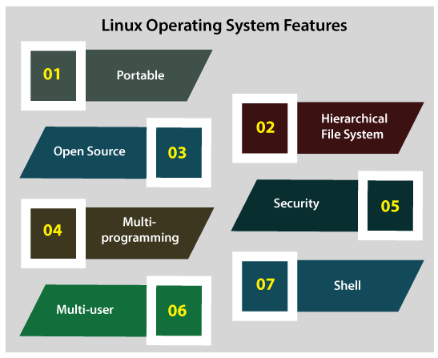
Design Principles
Portability
Hierarchical File system
Open-source, modular architecture
Multi-Programming
Security and stability are core design goals
Monolithic kernel with loadable modules
Shell
Emphasis on simplicity and efficiency
Follows POSIX standards for compatibility
Notes:
Open-source and modular:
Kernel source is freely available and modifiable.
community-driven development
Monolithic kernel with modules → large kernel but extendable at runtime
Portability
-Written mainly in C, allowing easy porting to different hardware.
-Runs on servers, desktops, mobiles, supercomputers
POSIX compliance
-maintains UNIX compatibility
Pipe-based composition
-Output of one command can be input of another
Simplicity and efficiency
-designed for stability and performance
Security
-multi-user system with strict permission models
Multi-user and multitasking
Supports multiple users and processes simultaneously.
Small, single-purpose utilities
Each command performs one task well
Example: ls, grep, awk, cat

Slide 10
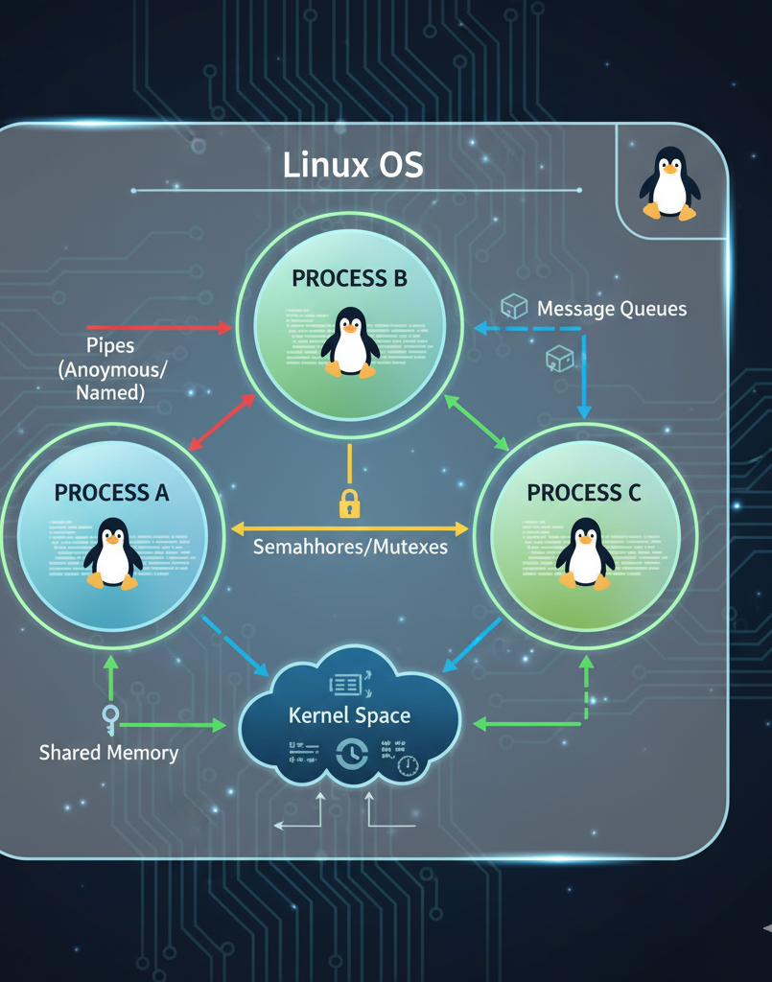
Inter-Process Communication
Pipes/FIFOs → data streams
Message queues → structured, asynchronous communication
Shared memory → fastest IPC, allows direct access but requires synchronization
Semaphores → control access to shared resources
Sockets → enable both local and network communication
Notes:
“Processes in Linux can’t directly access each other’s memory, so IPC provides mechanisms for communication and synchronization.
Pipes and FIFOs allow data to be passed in a stream between processes under same root/parent but in fifo these are named pipe that can be used by unrelated processes not just parent -child
Message queues let processes send and receive structured messages (as packets) asynchronously.
Each messase is identified by key (ID), any process can communicate as long as they know the queue id
It has fifo queue structure
Messages as persistence such that they stay in queue until read or deleate
Shared memory is the fastest (because processes directly read/write to memory without kernel intervention) IPC method because processes map the same memory region,
but it requires synchronization with semaphores (is a synchronization mechanism used to control access to a shared resource by multiple processes or threads.) .
Semaphores = synchronization tools for coordinating processes.
They prevent race conditions, ensure mutual exclusion, and help solve classic synchronization problems
For distributed systems, Linux provides
sockets, which work over networks or locally. Together, these methods make Linux highly versatile for everything from simple scripts to enterprise-level applications.”
Sockets are endpoints for bi-directional communication.
They can be used for local IPC or network communication.
Most modern client-server applications (web, email, chat, games) are built on sockets.
Pipes:
Unidirectional communication: between related processes (e.g., parent and child).
Data flows from the writing end of the pipe to the reading end.
Example: ls | grep txt where the output of ls is piped as input to grep.
FIFOs (Named Pipes):
Similar to pipes but allow communication between unrelated processes.
Created as special files in the filesystem using mkfifo.
Processes open the FIFO like a regular file for reading or writing.
Message Queues:
Allow processes to exchange messages in a structured manner.
Messages are placed onto a queue by one process and retrieved by another.
Offers more flexibility than pipes or FIFOs for asynchronous communication.
Shared Memory:
The fastest IPC mechanism, enabling processes to share a common region of memory.
Processes directly read and write to this shared memory segment.
Requires synchronization mechanisms (like semaphores) to prevent race conditions when multiple processes access the shared memory concurrently.
Shmget() , shmat()
Semaphores:
Used for synchronization and mutual exclusion to control access to shared resources (like shared memory).
They are essentially integer variables used to manage access, often with P (wait) and V (signal) operations.
Signals:
A limited form of IPC used for asynchronous notifications between processes.
One process sends a signal (e.g., SIGTERM, SIGKILL) to another, informing it of an event or requesting an action.
Do not carry data directly but can trigger specific signal handlers in the receiving process.
The choice of IPC mechanism depends on factors such as the relationship between processes, the amount and type of data to be exchanged, and the required level of synchronization.

Slide 11
Inter-Process Communication (IPC)
IPC Mechanism | Description | Use Case
Pipes | One-way communication between related processes | Parent–child processes
Named Pipes (FIFO) | Pipes with a name in filesystem | Unrelated processes
Message Queues | Structured message passing | Client-server models
Shared Memory | Common memory space shared by processes | High-speed data exchange
Semaphores | Synchronization and mutual exclusion | Prevent race conditions
Signals | Software interrupts | Process control
Sockets | Communication over network | Client-server networking

Slide 12
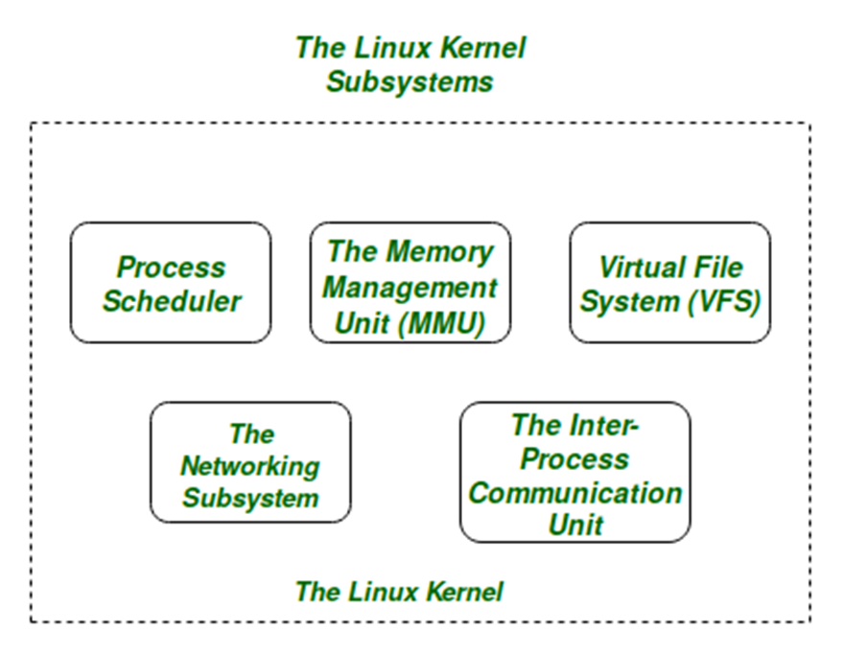
Kernel Modules
The kernel is the core part of an operating system (OS).
Kernel modules allow dynamic extension of kernel functionality without rebooting.
It is the bridge between hardware and software, managing system resources and enabling applications to run on hardware safely and efficiently.
Think of the kernel as the “brain” of the OS, controlling everything from CPU scheduling to memory management.
Notes:
Loadable modules add functionality without recompiling the kernel
Commonly used for device drivers, file systems, network services
Tools: insmod (insert module), rmmod (remove), lsmod (list)
Kernel modules allow dynamic extension of kernel functionality without rebooting.
Features:
Loadable at runtime (insmod, modprobe)
Removable (rmmod)
Reduce kernel size
Improve flexibility
Examples:
Device drivers
File system drivers
Network drivers
Advantages:
Faster development
Better memory utilization (load only when needed)
Easy maintenance (can debug/update modules separately)
High flexibility for developers
Functions of the Kernel
Process Management
Creates, schedules, and terminates processes.
Allocates CPU time fairly (e.g., FCFS, Round Robin, Priority scheduling).
Memory Management
Allocates/deallocates memory for processes.
Uses paging, segmentation, and virtual memory.
Device Management
Provides a uniform interface to hardware devices (printers, disks, network cards).
Uses device drivers to communicate with hardware.
File System Management
Manages files, directories, permissions, and storage.
System Calls / Interface
Provides an interface for user applications to request kernel services.
Example: open(), read(), write(), fork().
Security & Protection
Manages access rights and ensures processes don’t interfere with each other.
Types of Kernels
Monolithic Kernel
Entire OS (file system, device drivers, memory, scheduler) runs in kernel mode.
Fast, but large and harder to maintain.
Example: Linux, UNIX.
Microkernel
Minimal kernel, only basic services (IPC, scheduling, memory).
Other services (drivers, file system) run in user space.
More secure and modular, but slower (extra communication).
Example: Minix, QNX.
Hybrid Kernel
Mix of monolithic + microkernel features.
Better performance + modularity.
Example: Windows NT, macOS (XNU kernel).
Nano Kernel / Exokernel
Extremely minimal; delegates almost all services to applications.
Example: Some research OS designs.
Kernel vs Operating System
FeatureKernelOperating SystemDefinitionCore part of OSKernel + system programs + utilitiesRoleManages hardware + system resourcesProvides full environment for usersDirect use?No (indirectly via system calls)Yes (user interacts with shell, GUI, etc.)
Kernel Modes
Kernel Mode (privileged mode)
Kernel executes here with full hardware access.
Can execute all instructions.
User Mode
Applications run here with restricted access.
If they need hardware access, they make system calls to the kernel.
✅ Summary:
The kernel is the core of the OS that controls hardware, processes, memory, files, and devices.
It operates in kernel mode, while apps run in user mode.
Types: Monolithic, Microkernel, Hybrid, Nano/Exokernel.

Slide 13
Network Structure
Network Stack
The Linux kernel implements a modular network stack with layers following the OSI or TCP/IP model.
Network Interfaces
Physical or virtual interfaces connect the system to a network.
Routing Table
Linux maintains a routing table to determine how packets are forwarded.
Firewall and Packet Filtering
Network Namespaces
Provide isolated network environments for containers or virtualized applications.
Virtual Networking
Kernel Sockets
Sockets provide APIs for inter-process and network communication.
Notes:
Support for multiple protocols (IPv4, IPv6, etc.)
Linux uses a layered networking architecture.
Layers:
User Space
Applications (browser, FTP, SSH)
Socket Interface
Standard API for communication
Protocol Stack
TCP/IP, UDP, ICMP
Network Device Drivers
Ethernet, Wi-Fi drivers
Support for virtual networking (bridges, VLANs, VPNs)
Network Hardware
Key Features:
Full TCP/IP stack
packet filtering, Strong routing and firewall support (iptables, nftables)
Widely used as core OS in servers, networking devices, routers, and cloud systems

Slide 14
Drawbacks
Games
Hardware Drivers
Software alternatives
Learning curve

Slide 15

6.2 Windows
Windows follows a hybrid kernel architecture combining monolithic and microkernel concepts.

Slide 16
Different Versions
Release Year | Version
1985 | Windows 1.0
1995 | Windows 95
1998 | Windows 98
2000 | Windows 2000
2000 | Windows ME (Millennium Edition)
2001 | Windows XP
2007 | Windows Vista
2009 | Windows 7
2012 | Windows 8
2013 | Windows 8.1
2015 | Windows 10
2021 | Windows 11

Slide 17
Design Principles
Windows follows a hybrid kernel architecture combining monolithic and microkernel concepts.
Design Goals:
Ease of use
Backward compatibility
High performance
Security and reliability
Scalability
Characteristics:
GUI-centric
Strong hardware abstraction
Closed-source core
Notes:
Hybrid kernel → combines monolithic and microkernel advantages
Backward compatibility → supports legacy applications
Layered structure → modular separation of components
Hardware portability → runs on multiple architectures
GUI integration → user-friendly design for desktops

Slide 18
Program Interface
Event-driven programming
Rich GUI support
Extensive system libraries
Interface | Description
Win32 API | Core Windows API
.NET Framework | Managed code environment
Windows Runtime (WinRT) | Modern app development
POSIX Subsystem (earlier versions) | Limited UNIX compatibility
Notes:
Win32 API → core interface for applications
.NET Framework / WinRT → higher-level development tools
WSL (Windows Subsystem for Linux) → run Linux apps inside Windows
Driver Interface (WDM) → uniform standard for hardware drivers
Supports many programming languages (C, C++, C#, VB, etc.)

Slide 19
System Components
Windows OS is structured into user mode and kernel mode.
User Mode
Applications
Environment subsystems (Win32, .NET)
System services
Kernel Mode
Executive (process, memory, I/O management)
Kernel (low-level scheduling, interrupt handling)
Device Drivers
Hardware Abstraction Layer (HAL)
Isolates hardware-specific details
Improves portability across platforms
Notes:
Executive → memory management, I/O, security
Kernel → low-level scheduling, thread management, interrupts
HAL (Hardware Abstraction Layer) → isolates OS from hardware details
Device Drivers → interface to hardware
Subsystems → environments for running applications (Win32, .NET, POSIX in past)
User Mode vs Kernel Mode → ensures stability and security

Slide 20
6.3 Security Level in Linux
Linux security is permission-based and policy-driven.
Security Mechanisms:
User and Group permissions
Read (r), Write (w), Execute (x)
Ownership (user/group/others)
Access Control Lists (ACLs)
SELinux / AppArmor
Mandatory Access Control (MAC)
Firewall
iptables, nftables
Root privilege separation
sudo instead of direct root login

Slide 21
6.3 Security Level in Windows
Windows security is object-based and policy-centric.
Security Mechanisms:
User Account Control (UAC)
NTFS permissions
Access Tokens
Active Directory
Windows Defender
BitLocker encryption
Group Policy
Notes:
User Account Control (UAC)
UAC is a Windows security feature that prevents unauthorized system changes.
Runs users with standard privileges by default
Prompts for permission or admin credentials before critical actions
Reduces risk of malware gaining admin access
Example: Prompt appears when installing software.
NTFS Permissions
NTFS permissions control access to files and folders in Windows.
Permissions: Read, Write, Execute, Modify, Full Control
Can be assigned to users or groups
Supports inheritance and fine-grained access control
Used to protect sensitive files on NTFS file systems.
Access Tokens
An access token is a security identifier attached to a process or user.
Created when a user logs in
Contains:
User SID
Group SIDs
Privileges
Used by Windows to decide access rights
Windows checks the token before allowing resource access.
Active Directory
Active Directory (AD) is a centralized directory service used in Windows networks.
Manages users, computers, groups
Provides authentication and authorization
Supports domain-based administration
Common in enterprises for centralized control.
Windows Defender
Windows Defender is a built-in antivirus and security solution.
Protects against malware, viruses, spyware
Provides real-time protection
Integrated with Windows Security Center
Enabled by default in modern Windows versions.
BitLocker Encryption
BitLocker is a full-disk encryption feature in Windows.
Encrypts entire drives
Protects data if device is lost or stolen
Uses TPM (Trusted Platform Module)
Prevents unauthorized access to stored data.
Group Policy
Group Policy allows centralized configuration and management of systems.
Used in Active Directory environments
Controls:
Security settings
Software installation
User restrictions
Applied at domain, OU, or computer level
Simplifies large-scale system administration.

Slide 22
Comparison between Linux and Windows
Feature | Linux | Windows
Kernel type | Monolithic + modules | Hybrid
IPC | Pipes, MQ, Shared Mem, Sockets | Named pipes, mailslots, RPC
Security | SELinux, DAC, MAC | ACLs, UAC, BitLocker
Programmer Interface | POSIX, GNU/Linux APIs | Win32 API, .NET, WSL
System Philosophy | Open-source, flexible | Proprietary, user-friendly

Slide 23
Presentation Topics

Slide 24
Important Questions

